Slide 1

Finding Efficient Machine Learning Model for Hand Gesture Classification Using EMG Data
Adria Binte habib
22366041

Slide 2
Introduction
Problem Statement
Goal

Slide 3
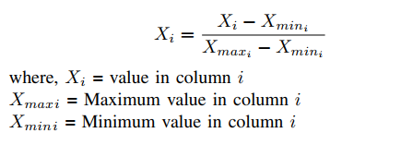
Data Analysis
Dataset Description
Dataset Preprocessing

Slide 4
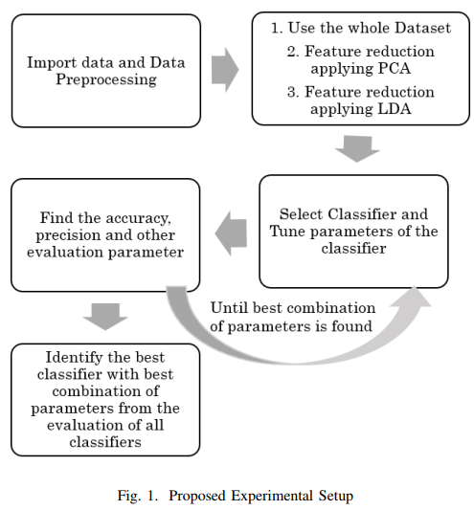
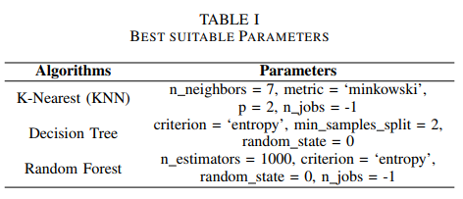
Methodology
Proposed Pipeline
Experimentation

Slide 5
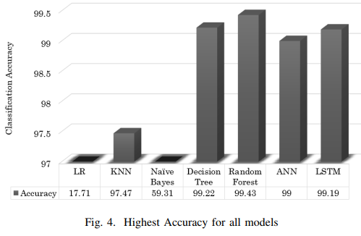
Result Analysis
Performance of
Traditional Models
Performance of
Deep Learning
Models

Slide 6
Conclusion
Summary
Contribution

Slide 7
Link of the Paper
Click Here

